Slide 2
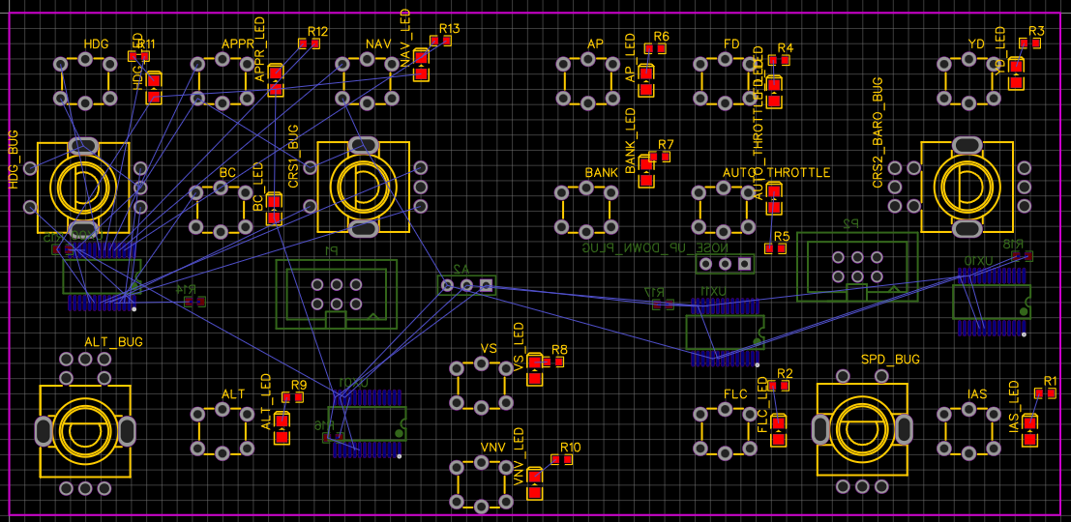
PDF/MFD multi
PFD
Pages
GOTO
FPL
CLR
RK
MFD
MENU
PROC
ENTER
RADIO
Radio
COM FREQ
SWAP
Radio
SWAP
NAV FREQ
MODE
MODE
COM3, ADF, DME…
COM
A
MRKR MUTE
COM1
COM2
COM3
NAV1
NAV2
VOLUME/SQ
O
SENS
MIC1
MIC2
MIC3
DME
ADF
M
AP
HDG
APR
NAV
AP
FD
YD
HDG
BC
CRS1
BANK
AT ?
CRS2/ BARO
ALT
ALT
VS
FLC
SPD
IAS
VNV
LIGHT
DIMM
LIGHT

Slide 3
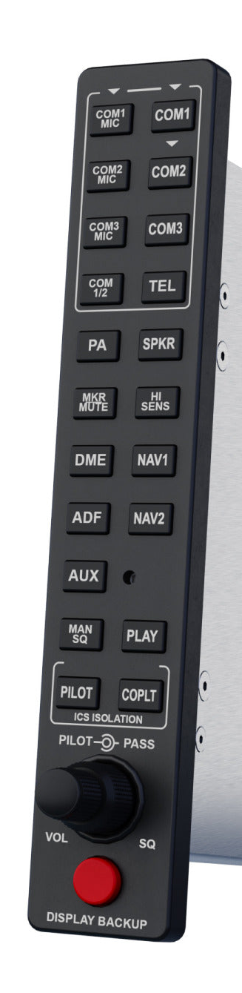
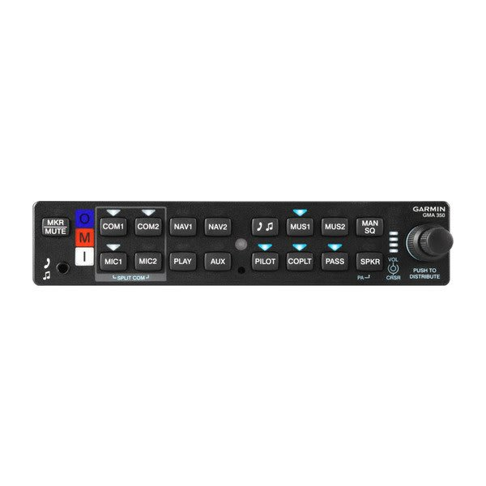

Slide 4
NAV ACTIVE FREQUENCY:index
COM ACTIVE FREQUENCY:index
COM1 STORED FREQUENCY
NAV STANDBY FREQUENCY:index
COM STANDBY FREQUENCY:index
NAV1
COM1
NAV IDENT, NAV NAME
121.40
114.70
120.750
121.408
COM ACTIVE FREQ IDENT:index/COM ACTIVE FREQ TYPE:index
NAV RADIAL/NAV VOR DISTANCE
183° 83NM
RBT
LFPN TWR
183° 83NM
COM ACTIVE BEARING:index/COM ACTIVE DISTANCE:index
TYPE : ILS, VOR, VORDME
NAV2
COM2
121.40
115.65
121.408
121.408
EPR
TX
NAV ACTIVE FREQUENCY:index
NAV STANDBY FREQUENCY:index
ADF IDENT
ADF
121.40
115.65
NAV RADIAL/NAV VOR DISTANCE
183° 83NM
EPR
COM AVAILABLE:index : pour paramétrer système
COM SPACING MODE:index
https://docs.flightsimulator.com/html/Programming_Tools/SimVars/Aircraft_SimVars/Aircraft_RadioNavigation_Variables.htm

Slide 5
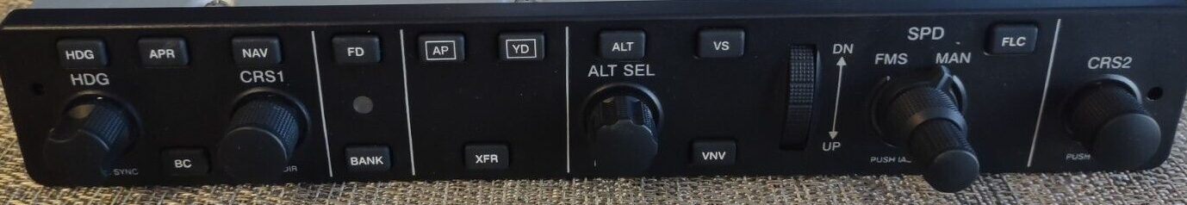
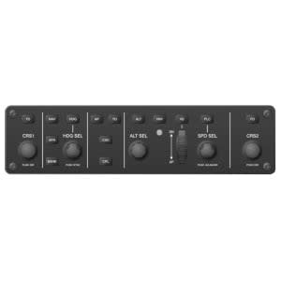
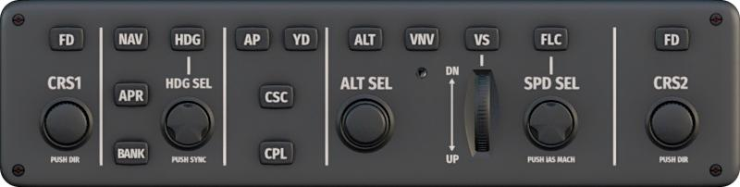
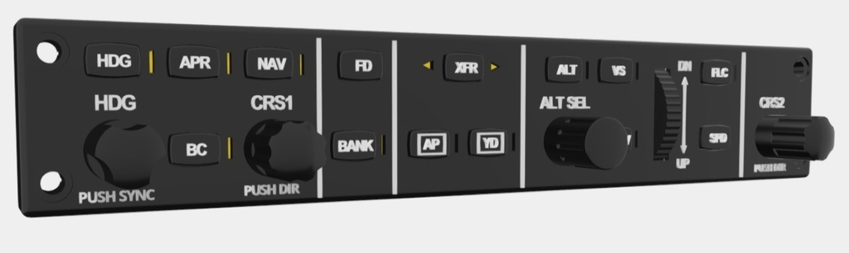
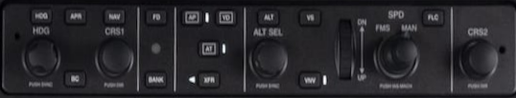
To scale
AP
HDG
APR
NAV
AP
FD
YD
HDG
BC
CRS1
BANK
AT ?
CRS2/ BARO
ALT
ALT
VS
FLC
SPD
IAS
VNV

